Slide 1
AERONAUTICAL RADIO OF THAILAND LTD.

Slide 2
Products and Services
Three - Dimensional ATC Aerodrome Simulators
Airline Operational Control Service (AOC)
Training (ATC and Engineer)
Flight Inspection and Validation Service
Flight Procedure Design Service
RAIM Prediction Service

Slide 3
Flight Inspection and Validation Service

Slide 4
Video Presentation

Slide 5
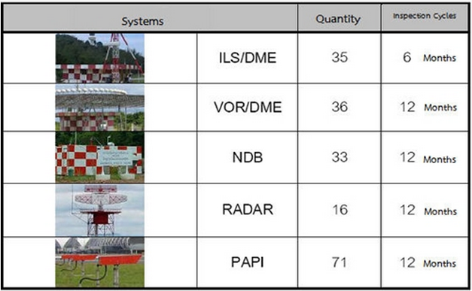
Flight Inspection and Validation Service
Established since 1968
Sole Flight Inspection and Validation service in Thailand
48 PBN procedures

Slide 6
AEROTHAI’s Fleet
4 aircrafts (Beechcraft Super King Air 200 and 300 )

Slide 7
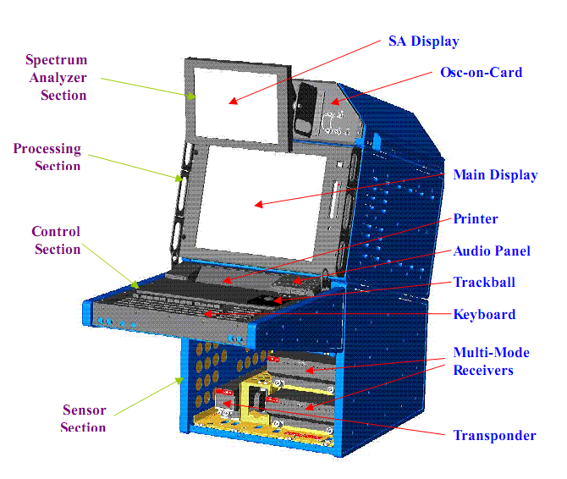
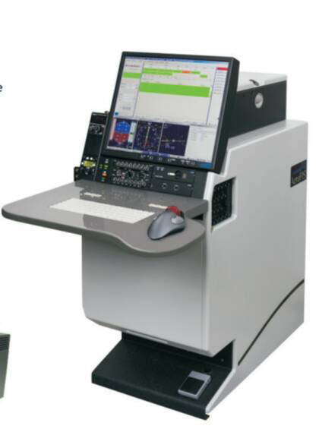
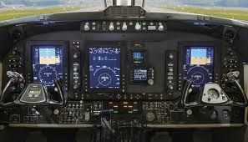
Automatic Flight Inspection and Validation System
AERO DATA/Normarc Flight Inspection Systems
ICAO Doc 8071 and FAA OAP .8200 flight inspection guidelines
Capable to automatically record GNSS Data for future analysis as necessary

Slide 8
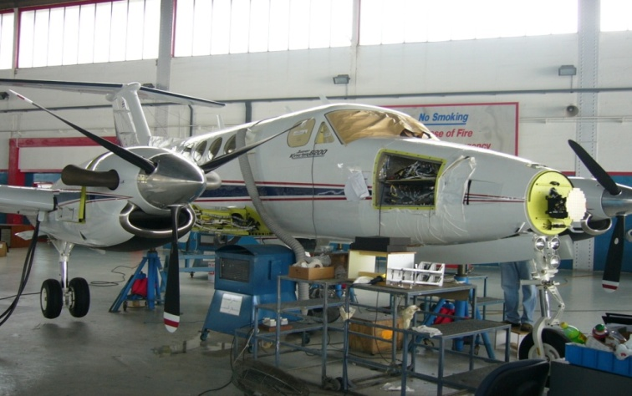
Flight Inspection Team
Aircraft Operation Department
8 Flight inspection pilots
15 Flight inspection engineers
Aircraft Engineer Department
17 Aircraft engineers

Slide 9
Flight Inspection and validation service aboard
Bhutan
Brunei
Cambodia
Lao People's Democratic Republic
Myanmar
Nepal
Republic of China (Taiwan)

Slide 10
Successful projects
Flight Validation Service for PBN Procedure, Republic of China (Taiwan) in 2008 – 2009
Flight Inspection Service for ADS-B, Republic of China (Taiwan) in 2010
Flight Inspection and Validation service for all airports in Nepal 2011 – 2014
Flight Inspection and Validation service for all airports in Lao People's Democratic Republic 2008 – 2015
Flight Inspection and Validation service for all airports in Bhutan 2010 – 2015
Flight Inspection and Validation in Cambodia, 2014-2015
**

Slide 11
Flight Procedure Design Service

Slide 12
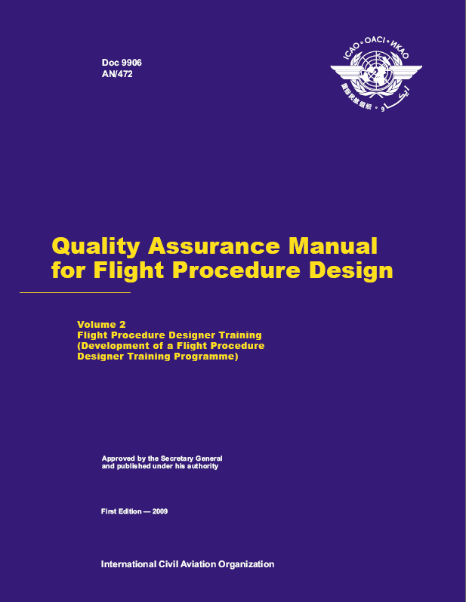
Flight Procedure Design Training Phases
Ab initio Training
Basic Aviation course
AIS Cartography
Initial Training
Basic PANS-OPS
PBN
On-the-job Training (OJT)
In-house OJT
Advanced Training
RNP AR
Instructor course
Recurrent Training
Refresher Training

Slide 13
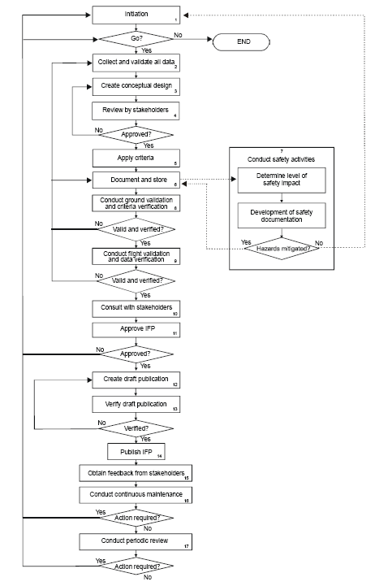
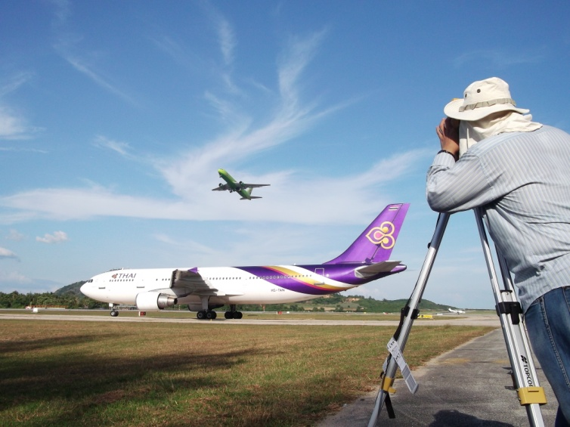

Slide 14
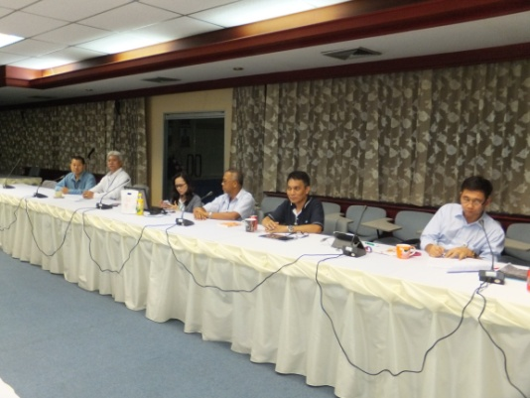
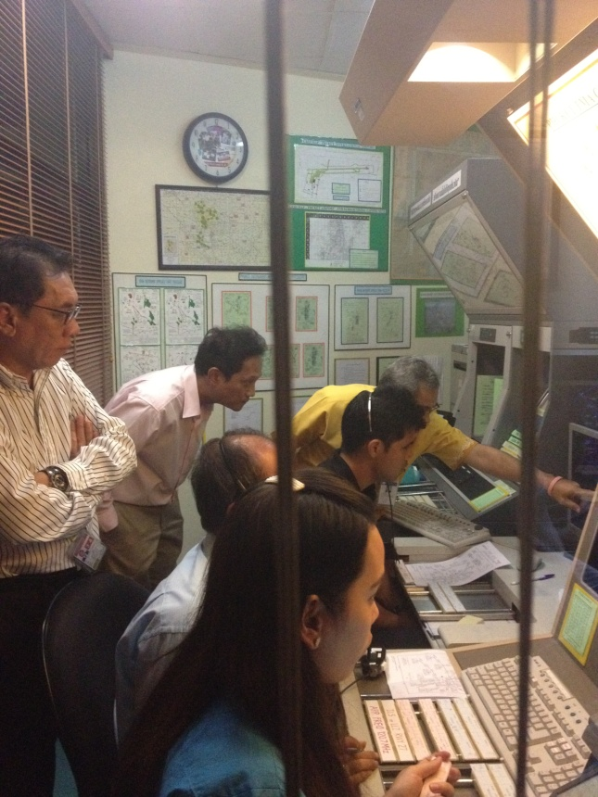

Slide 16
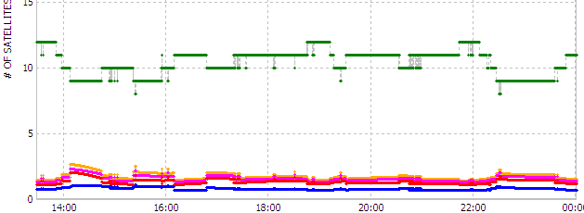
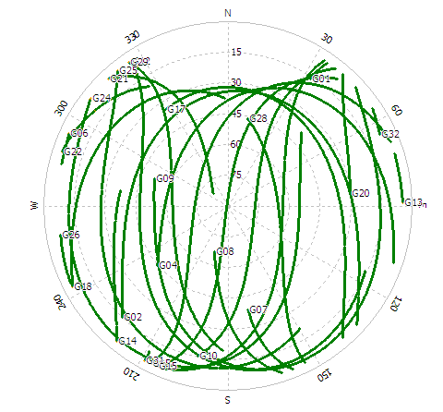
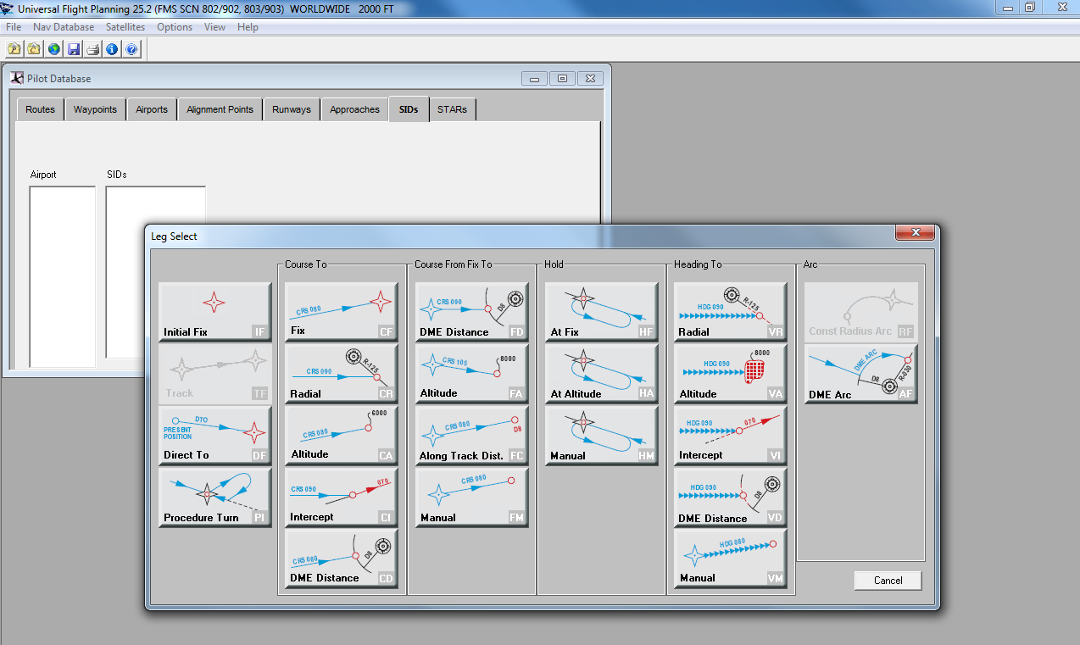

Slide 17
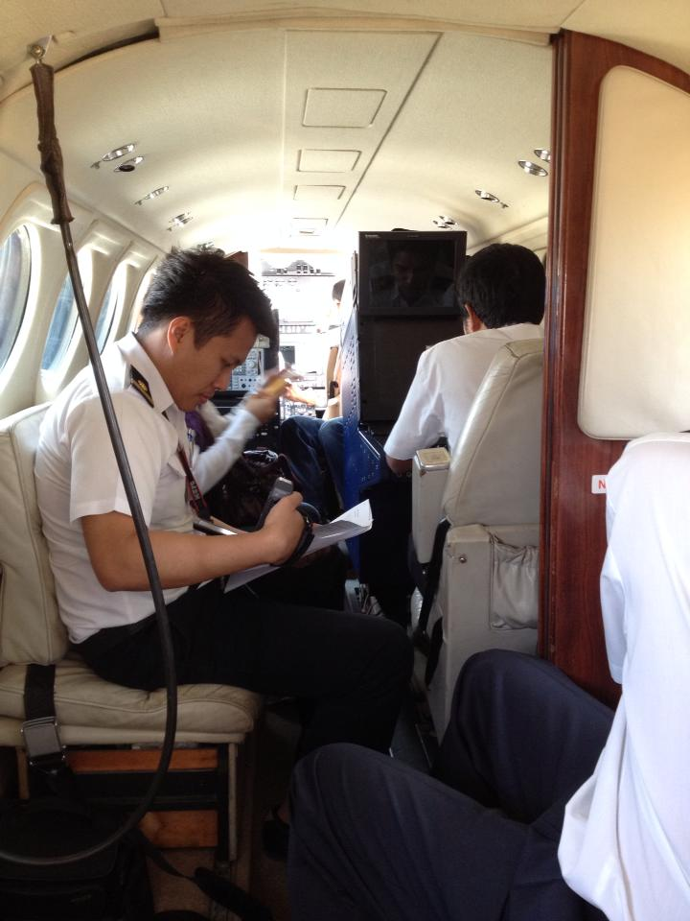
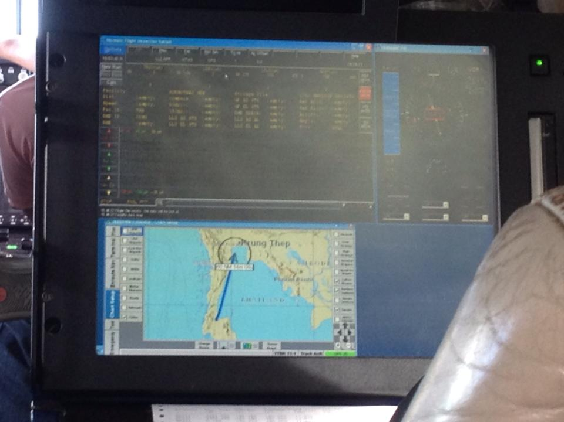
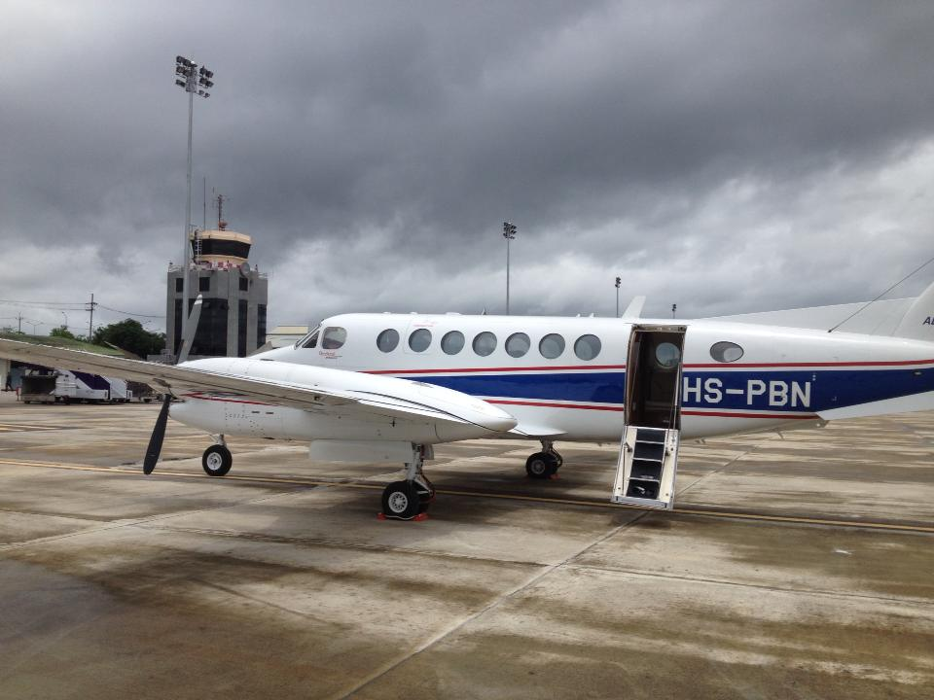

Slide 18
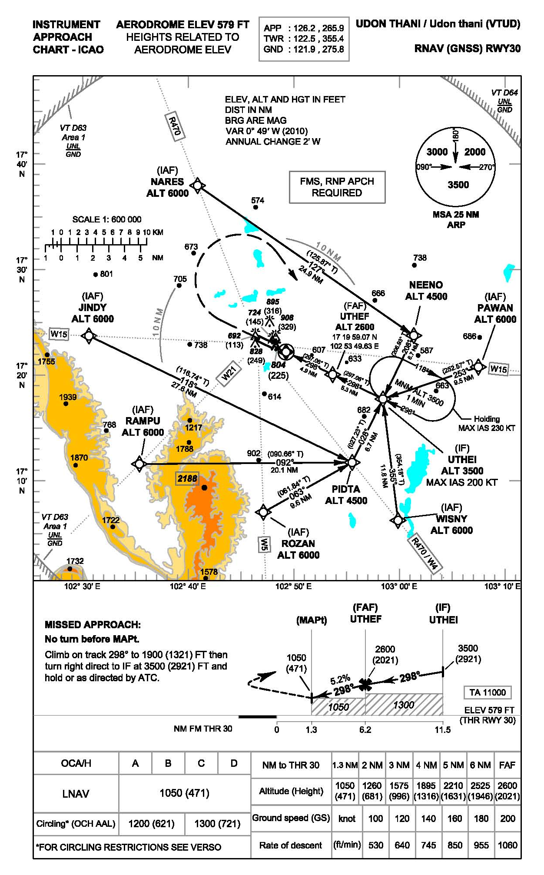

Slide 19
Automation Tools
Universal Avionics Flight Planning
PANADES
AutoCAD Civil 3D
Spread Sheet
Etc.
Google Earth
COMSYS
ArcGIS

Slide 20
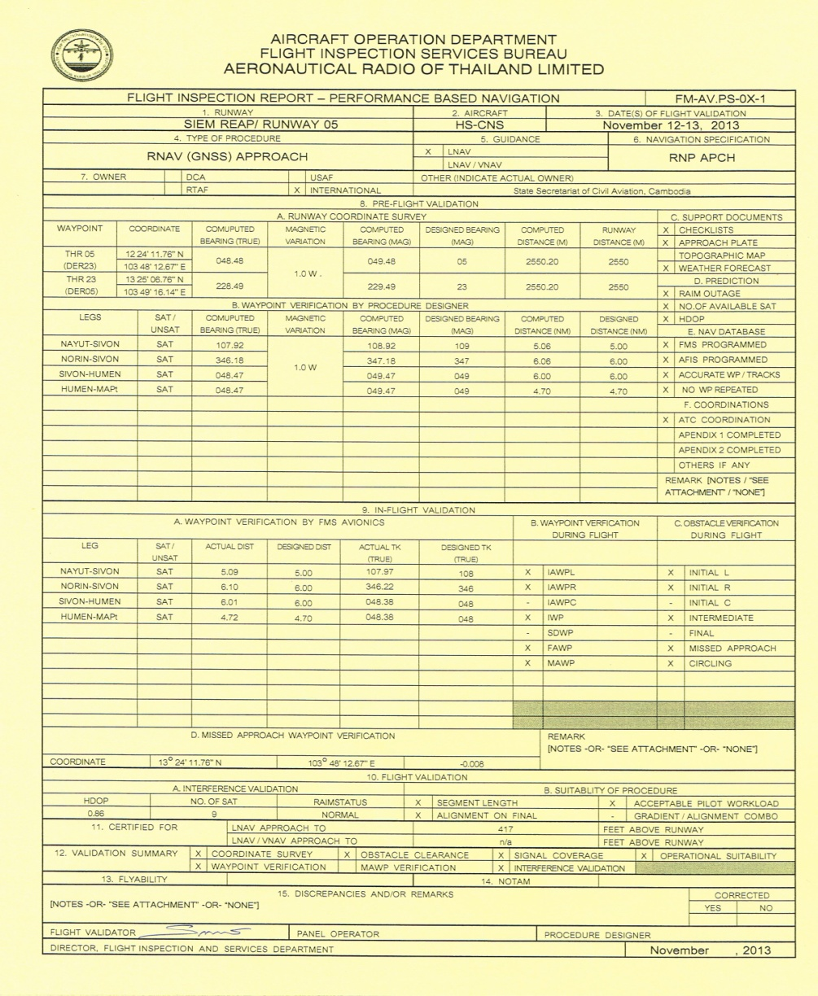
Flight Validation Report in compliance with ICAO Doc 9906

Slide 21
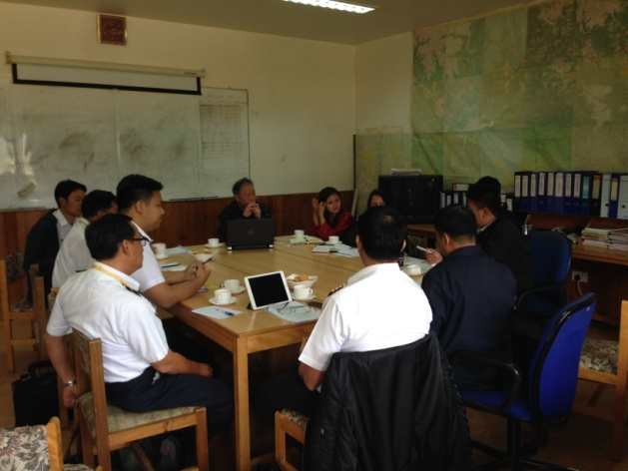
Flight Validation for PBN Aboard

Slide 22
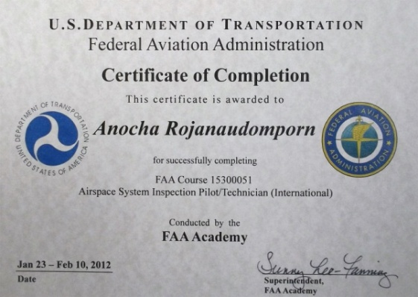
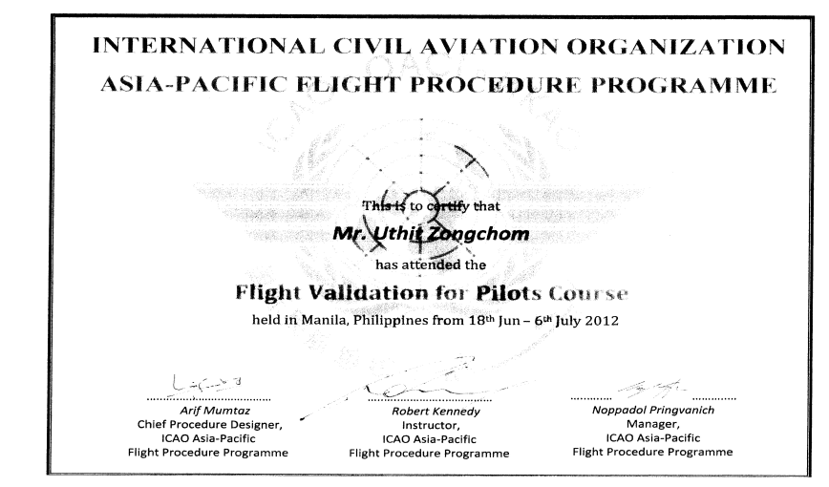
Service and Safety Standard

Slide 23
NETRA RAIM Prediction Service

Slide 24
Flight Inspection and Validation Service
Mr. Tirachai Sungkasap
artflightcheck@yahoo.co.uk
Tel: +6681-734-9242
Fax: + 662-285-9565

